Slide 1
Stop manually publishing your PowerShell modules
Automate it in 2 minutes!
Daniel Schroeder
@deadlydog

Slide 2
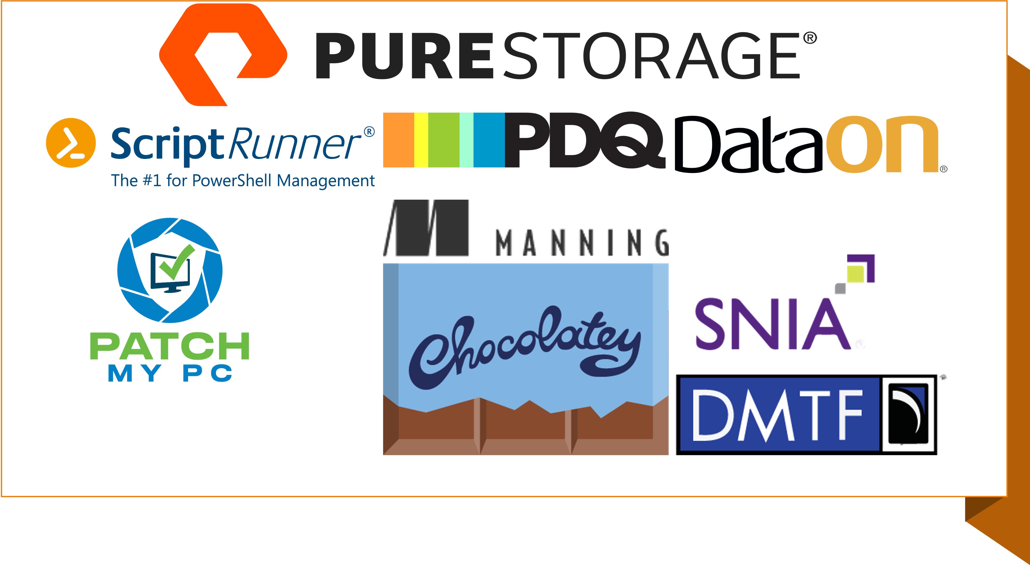

Slide 3
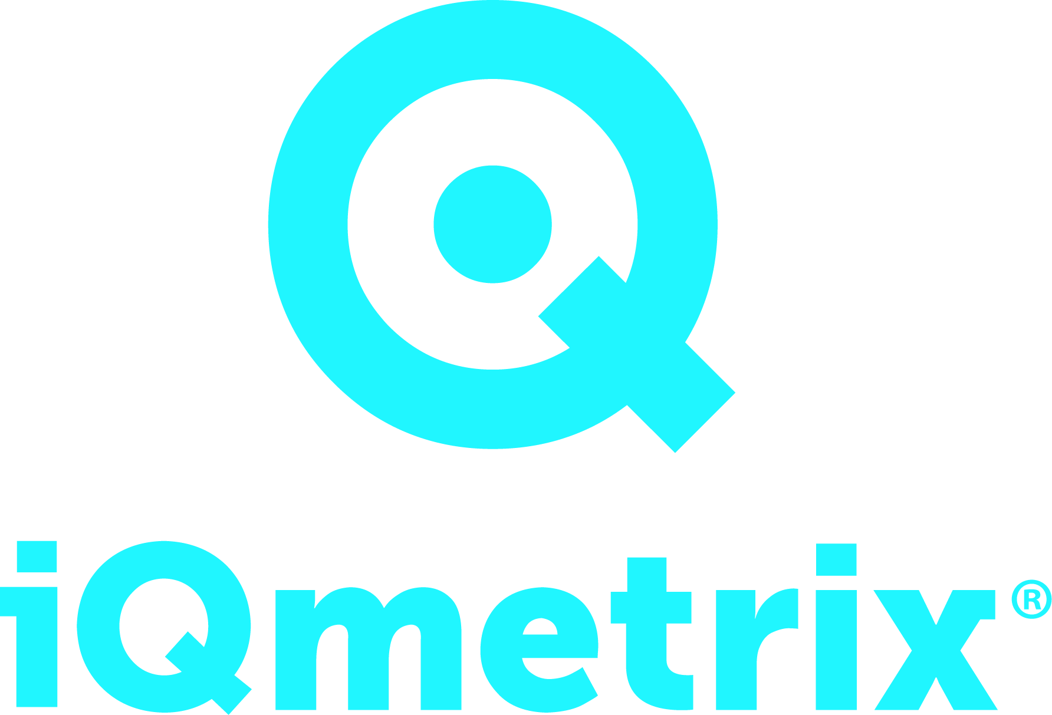
Thank you iQmetrix
iQmetrix’s purpose is to Create Great Experiences. We aim to enrich the lives of our employees, our partners, our clients, and their customers by enabling a wireless retail experience that’s as human as our fundamental need for connection.

Slide 4

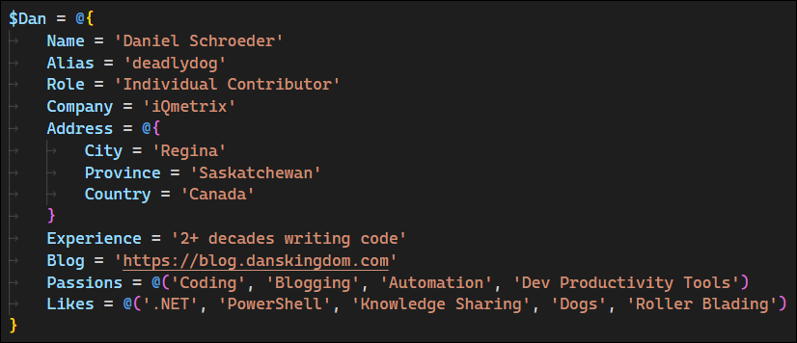
About Dan
Notes:
- @deadlydog
- Individual Contributor at iQmetrix
- Writing software for over 2 decades
- Blogging for over a decade: https://blog.danskingdom.com
- Passionate about automation and developer productivity tools

Slide 5
Agenda
Why use modules?
Why automate publishing?
Ways to automate publishing
Demo
Wrap up
Questions

Slide 6
Why use modules?
Easy to install
Easy to update
Easy to use
Install-Module (Install-PSResource)
Update-Module (Update-PSResource)
& C:\Some\Path\Script.ps1
Notes:
- Install the module with a single command
- Don’t have to worry about where the script is stored. No tracking down a file share, GitHub gist, git repository, etc.
- Update to the latest version with a single command
- Don’t have to inspect script contents to ensure you have the latest version
- Call the cmdlets without worrying about where the script’s file path is

Slide 7
Evolution to modules
1. Run commands in the terminal
2. Put commands into a script
3. Put Params on the script
4. Turn the script into a module
Not every script needs to be a module
Good candidates: Used/updated frequently, shared with others
Notes:
Example: Retrieve app service information from Azure and display it in a report.
Modules have a bit of extra overhead, like the manifest file.
Good candidates for converting scripts to modules:
- Scripts that you find yourself and your team using all of the time or commonly sharing with others
- Scripts that are made up of many different files

Slide 8
Publishing a module is easy
Publish-Module (Publish-PSResource)
-Path C:\PathTo\MyModule –NuGetApiKey *****
-Repository MyInternalPowerShellFeed
Notes:
- ASK: How many people publish modules, either personally or at their organization?
- ASK: How many people manually type this command to publish their modules?

Slide 9

Oh right, version number
Notes:
- Need to update the version number in the module manifest .psd1 file

Slide 10
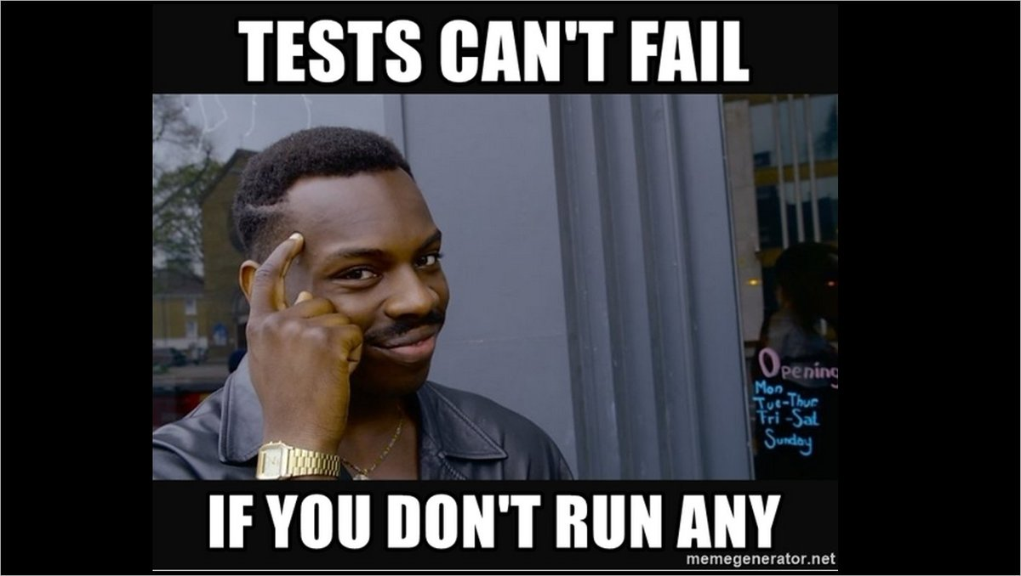
Oh right, tests
Notes:
- Someone files a bug for a use case you know you wrote a test for….. Oh, I forgot to run the tests before publishing the new version *facepalm*

Slide 11
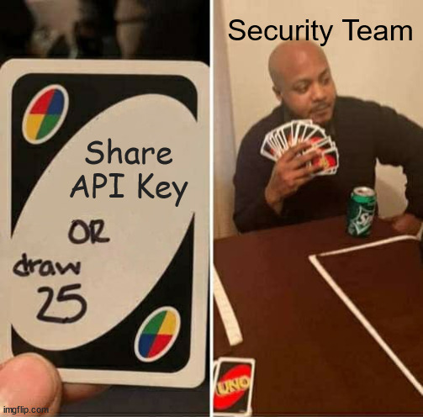
Oops, only I have the API key
Notes:
- Coworker wants to publish a new version.
- Ideally you store the API key (or user credentials) in a key vault or password manager to share with team members; very likely it ends up in a local txt file on their machines or shared in plain text over Slack.
- Please do not store the API key in source control.

Slide 12
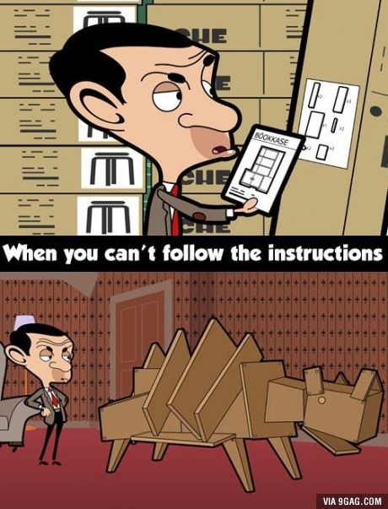
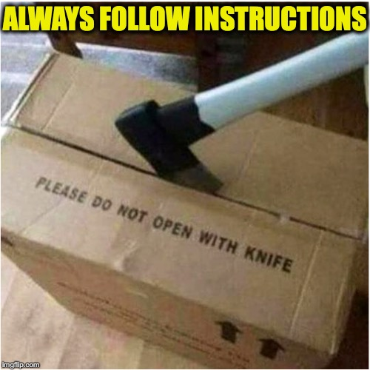
Time for deployment instructions
Notes:
- Better than having to remember all the steps, but not perfect:
- Instructions are not always clear to everyone.
- People can miss steps or make mistakes.
- Once someone has done the process a few times, they may not use the instructions anymore and miss when it is updated.

Slide 13
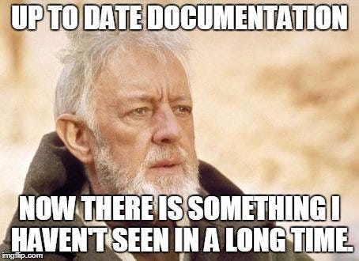
Regenerate documentation
Notes:
- Can use libraries like PlatyPS to generate external documentation.

Slide 14
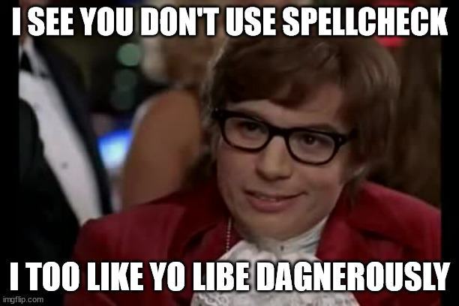
Spellcheck code and docs
Notes:
- Spellcheck can be especially important in highly visible open-source projects.

Slide 15



Oh right, restrict access
Notes:
- Only certain people should be allowed to publish new versions

Slide 16



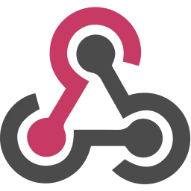
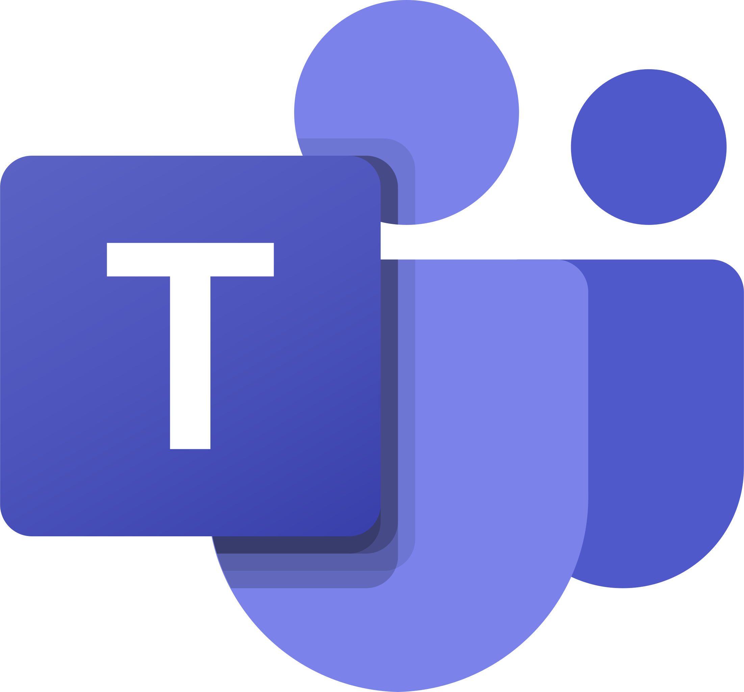

Send notifications

Slide 17
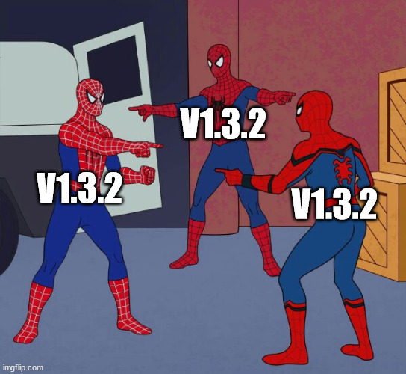
Tag commit with the version number
Notes:
- Need to know which git commit corresponds to a published version.

Slide 18

Let’s write a deployment script!
PS> See-CheckList | Write-AutomationScript
An improvement, but we can do better with
Pipelines!
Actions / Workflows
Notes:
- I love checklists because it means I can automate them.
- Faster and more accurate. Removes much of the manual parts, which are easy to make mistakes with.
- ASK: How many people publish their modules by manually running a script?
- Not everything can be automated or enforced with a script though, or it doesn’t necessarily lead us to best practices.
- The next slides show things that are hard to enforce with a script, but easy with a pipeline.

Slide 19
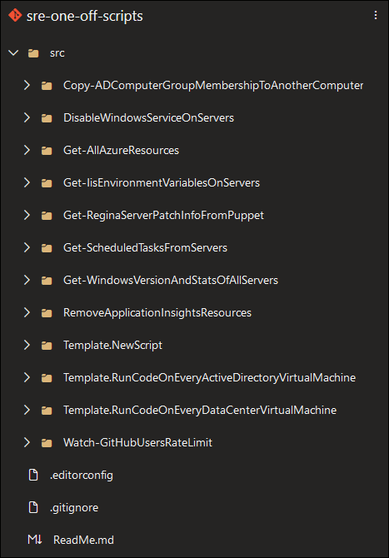

Use source control
Notes:
- Source control should be table stakes; allows you to see who made what changes when and why, and easily rollback if there are issues.
- Creating a git repo for every little script can be a lot of overhead, so create a General Scripts dumping ground repo, and move scripts into their own repo as they grow.

Slide 20
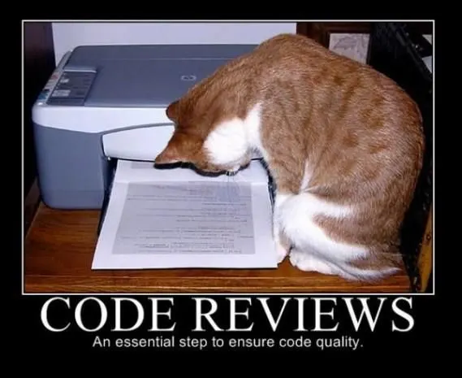
Don’t forget code reviews
Notes:
- Can use branch policies to ensure no changes are pushed directly to the main branch, so PRs must be used and approved

Slide 21
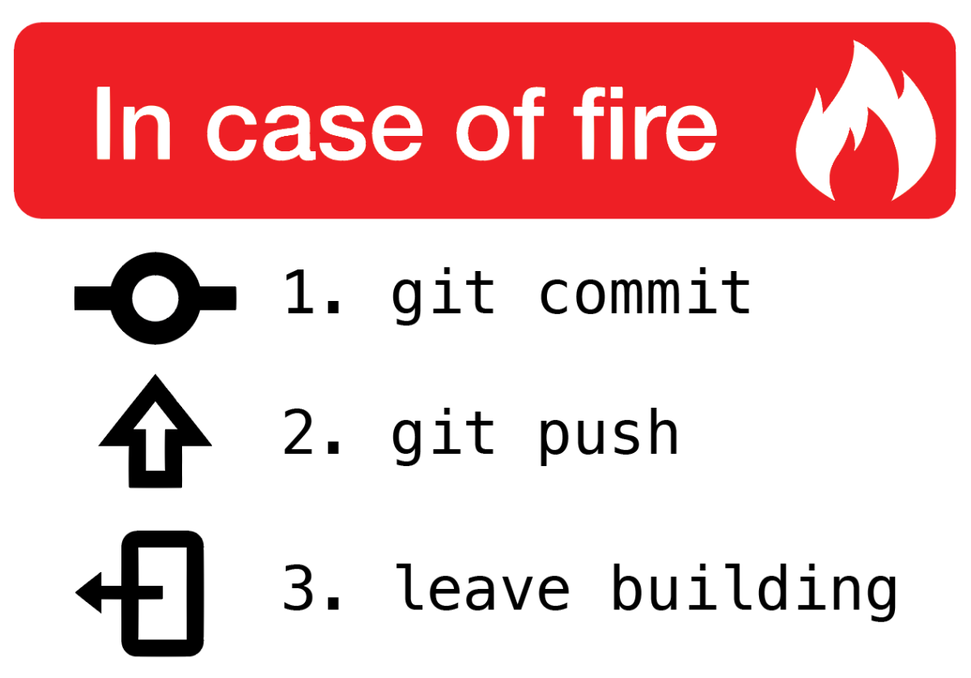
Oh right, push your code up
Notes:
- If you forget to push your code up, it only exists on your local machine
- What if your hard drive dies, or your colleague wants to make changes

Slide 22
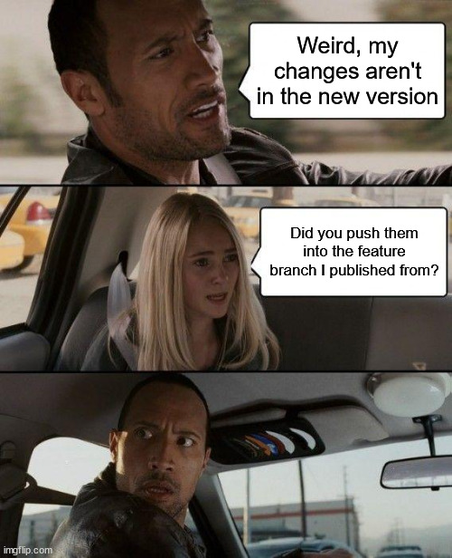
Publish from the main branch
Notes:
- ASK: How many of you have accidentally pushed changes to the wrong branch? It’s just as easy to run a deployment script from the wrong branch.

Slide 23
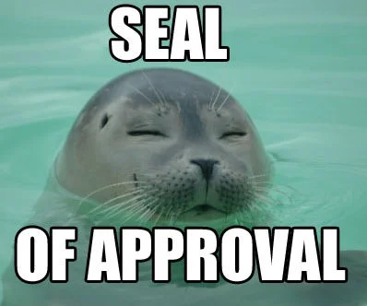
Get approval
Notes:
- Do you need your tech lead or another department (like security or change management) to approve the deployment?

Slide 24
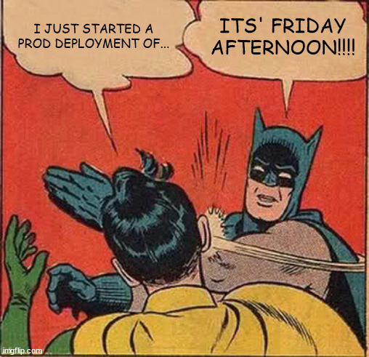
Deployment schedules
Notes:
- Maybe deployments are only allowed in the evenings, or on certain days.
- Can also setup automatic nightly deployments.

Slide 25
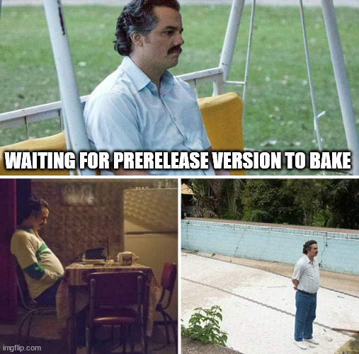
Baking new versions
Notes:
- e.g. We are supposed to have the prerelease version published for at least 48 hours before publishing the stable version.
- Pipeline can automatically publish the stable version after 48 hours if the pipeline has not been cancelled.

Slide 26
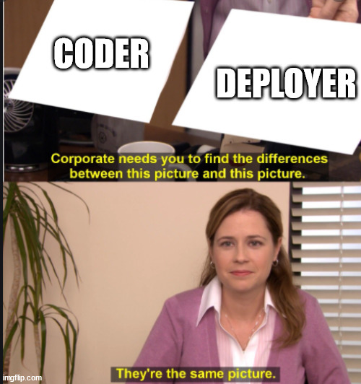
Compliance
Notes:
- Separate the deployer from the code writer for audits (PCI, SOC, etc.)

Slide 27
Why use a pipeline?
Helps enforce good practices:
Source control
Enables branch policies for code reviews
Code must be pushed to remote repo
Only publish from the main branch by default
Enables approvals and deployment schedules
Long-running deployment processes
Pit of Success

Slide 28
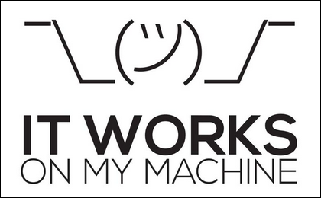
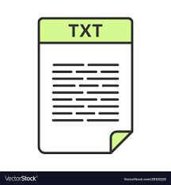



Why use a pipeline?
Notes:
Get some things for free out-of-the-box:
Consistency and repeatability
Logging (persisted) and Visibility
Security (no sharing of API key)
Auditing
Notifications (users can opt into email notifications themselves)
Not just for deployments; can be useful for other things like cron jobs or manually ran scripts

Slide 29
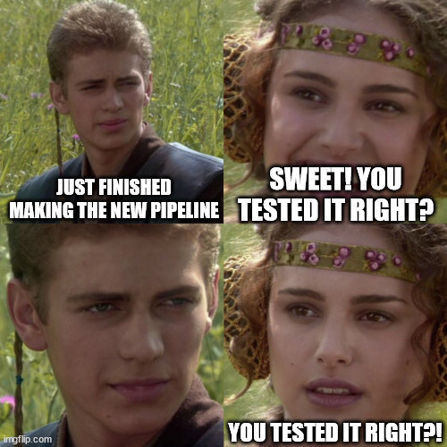
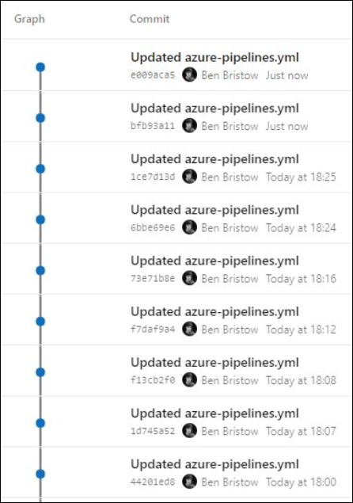

Testing pipelines can be…..
frustrating
Notes:
- ASK: Who here has setup a build or deployment pipeline before?
- It’s rare to get it right on the first try.

Slide 30
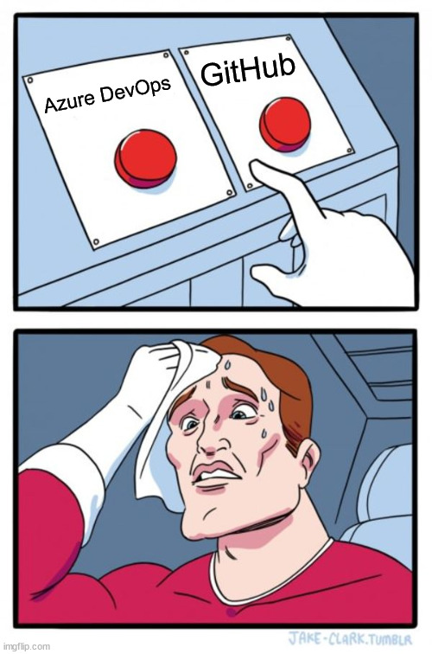
Demo
Let’s publish a new module!
github.com/deadlydog/PowerShell.ScriptModuleRepositoryTemplate
Notes:
- ASK: How many of you use Azure DevOps? How many use GitHub? How many use both?
- Use module to create a new Repo directory.
- Create a new PSSummit2024TestRepo repo from the GitHub template: https://github.com/deadlydog/PowerShell.ScriptModuleRepositoryTemplate
- Clone it to local machine and run _InitializeRepository.sp1 script.
- Follow ReadMe instructions to create API key and change 3 settings.
- Commit and push files.
- Open repo in VS Code to show running PSScriptAnalyzer and Tests tasks.
- Look at completed/in progress Actions and go over them.

Slide 31
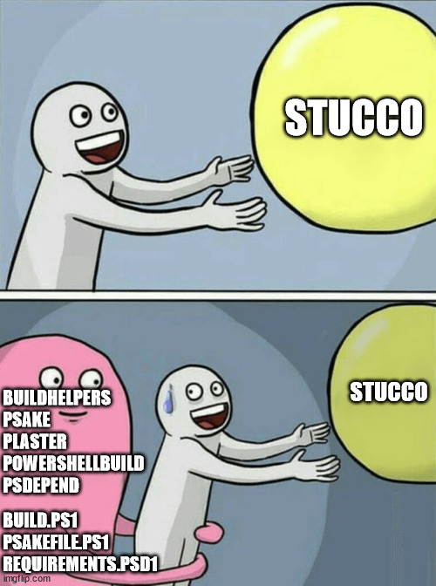
Other templates?
PSModuleTemplate
ModuleTemplate
No docs
Module.Template
AppVeyor for CI/CD
Stucco
PSModuleDevelopment
Notes:
- Module.Template used the external AppVeyor platform for the CI/CD system.
- Stucco requires installing a bunch of additional modules and learning the build frameworks.
- PSModuleDevelopment – Friedrich (Fred) Weinmann – Build C# apps and deploy to Azure Functions.

Slide 32
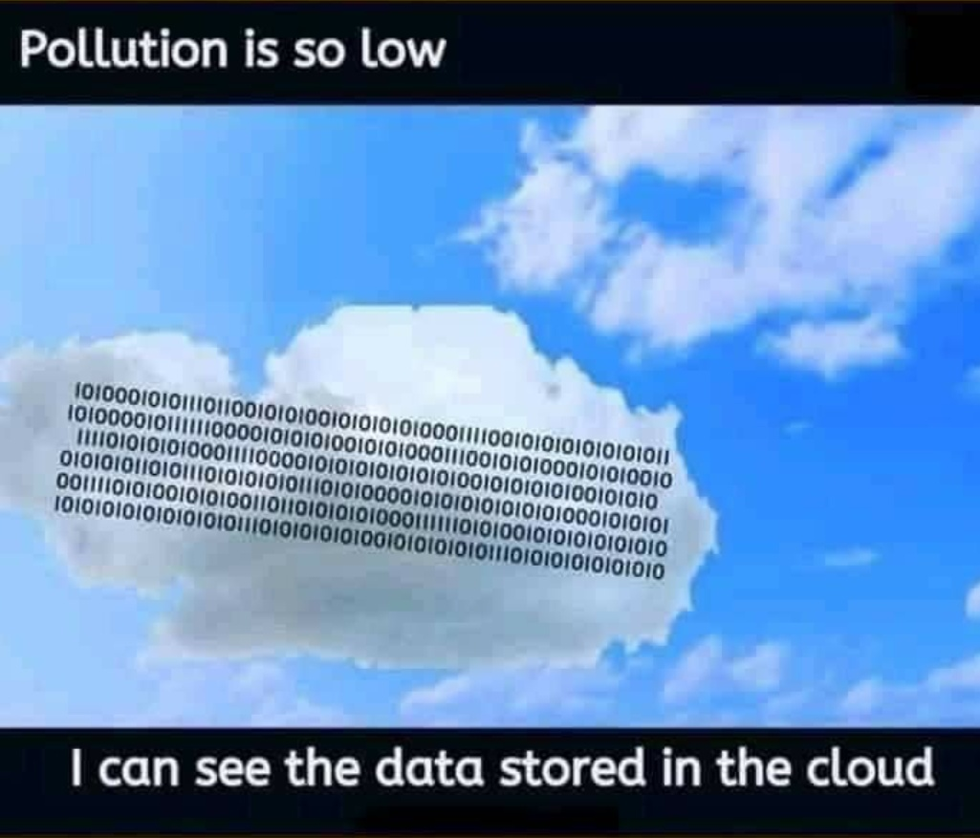
Pipelines aren’t all sunshine
Notes:
- Pipelines have their own drawbacks:
- Sometimes MS updates their cloud agents and breaks something you depend on.
- Not necessarily free.
- Email notifications for pipelines that were never approved after they expire.

Slide 33

Scripts vs. Marketplace
Notes:
- Marketplace can get you up and running quickly, but then you have an external dependency that could break, get deprecated, or be vulnerable.
- Writing scripts gives you full control and can run locally, but you need to maintain it.

Slide 34
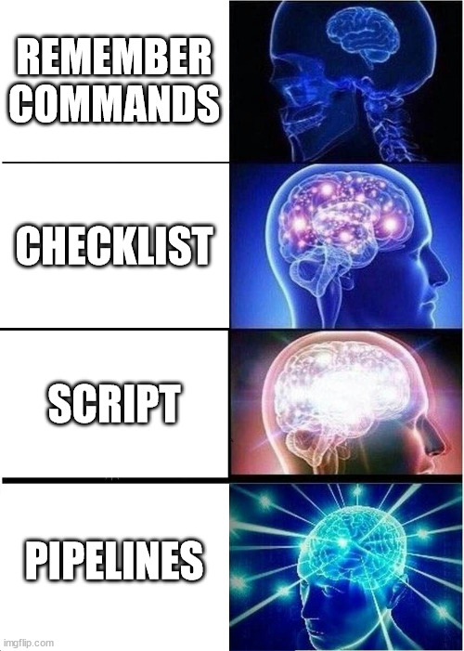
Recap
Pipelines over manual script running:
Consistency and repeatability
Logging (persisted) and Visibility
Security (permissions and API keys)
Auditing
Notifications
Approvals and schedules
Compliance

Slide 35




THANK YOU
Please review this session
twitter.com/deadlydog
github.com/deadlydog
blog.danskingdom.com
Demo module/template:
ScriptModuleRepositoryTemplate

Slide 36
Heading

Slide 37
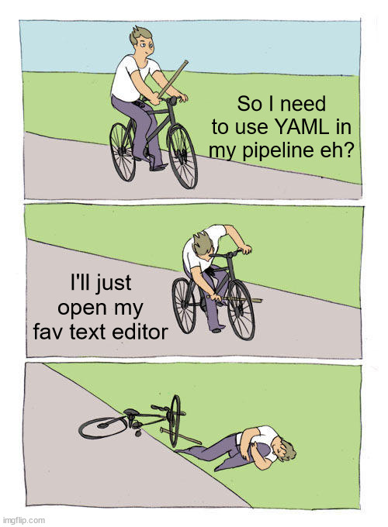
Pipeline YAML
Web editor is king
VS Code extensions
GitHub Actions
Azure Pipelines
Syntax highlighting, autocomplete, etc.

Slide 38
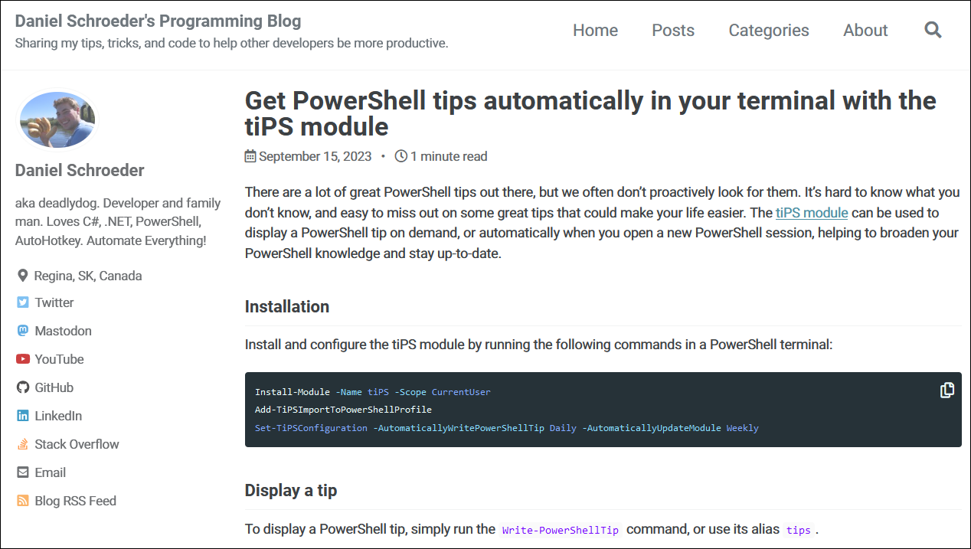
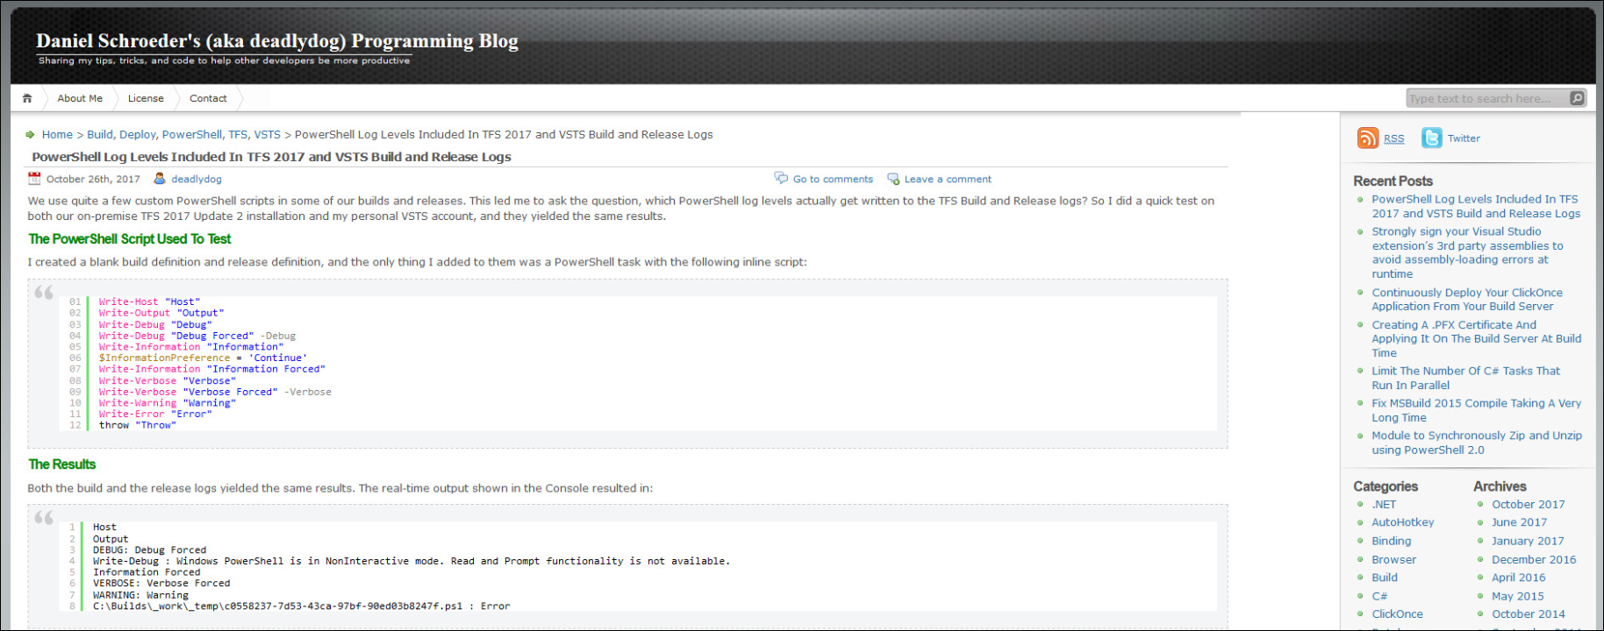
Notes:
- This is what my blog looks like now
- and before 2020
- If either look familiar, then you’ve likely visited my blog before

Slide 39

Why use pipelines?
Notes:
- Manually publishing scripts is like requiring your team to see a Magic Eye image
- Not everyone can figure out how to do it
- Even if they can, it often takes them a while (install dependencies, etc.)

Slide 40



Slide 41
